Slide 1


RFM-BASED
reallygreatsite.com
CUSTOMER SEGMENTATION ANALYSIS
Prepared by
Niloy Saha
Data analyst

Slide 2

Table of
Contents
Introduction & Objective
Dataset Overview
Data Cleaning & Preparation
Feature Engineering
Customer distribution and sales
Understanding RFM Analysis
Customer Segmentation Logic
Types of customers
Customer Segment
Deep drive to UK Business Recommendations
Conclusion
01
02
03
04
05
06
07
08
09
10
11
12

Slide 3

INTRODUCTION
AND
OBJECTIVE
Introduction
In today’s competitive retail environment, understanding customer behavior is essential for increasing sales and improving retention. Transactional data contains valuable information about how often customers purchase, how recently they purchased, and how much they spend.
RFM analysis is a data-driven technique used to segment customers based on purchasing behavior.
Objective
Analyze customer purchasing patterns
Segment customers based on value and activity
Identify high-value, at-risk, and inactive customers
Provide actionable insights for business decisions

Slide 4
Business Problem Statement
Problem
Business Question
All customers are often treated the same in marketing campaigns
This leads to inefficient spending and poor targeting
High-value customers may churn without timely intervention
Who are our most valuable customers?
Which customers are likely to churn?
Where should the company focus retention efforts?

Slide 5
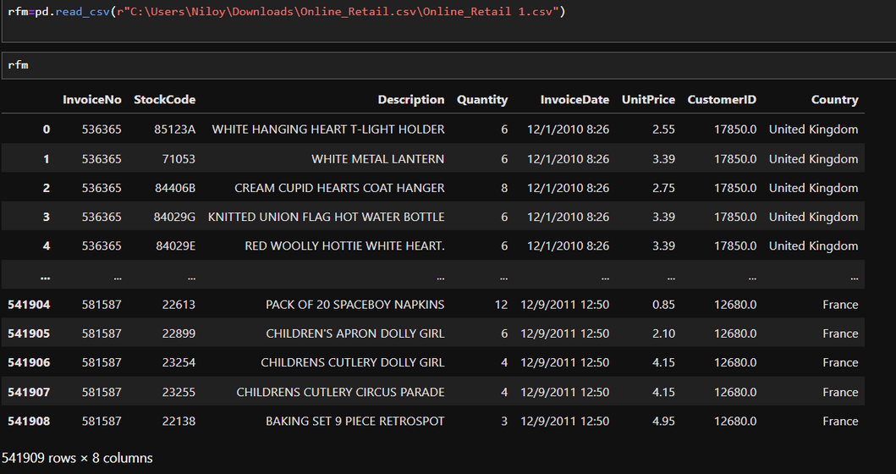
Dataset Overview
Data set
Online retail transactional dataset
Covers customer purchases between 2010 and 2011
Total rows=5 lakh+
Total columns= 8
CustomerID: Unique customer identifier
StockCode:5-digit integral number uniquely assigned to each distinct product.
Description:About the product
InvoiceDate: Date of purchase
Quantity & UnitPrice: Used to calculate spending
Country: Customer location
Key Variables

Slide 6
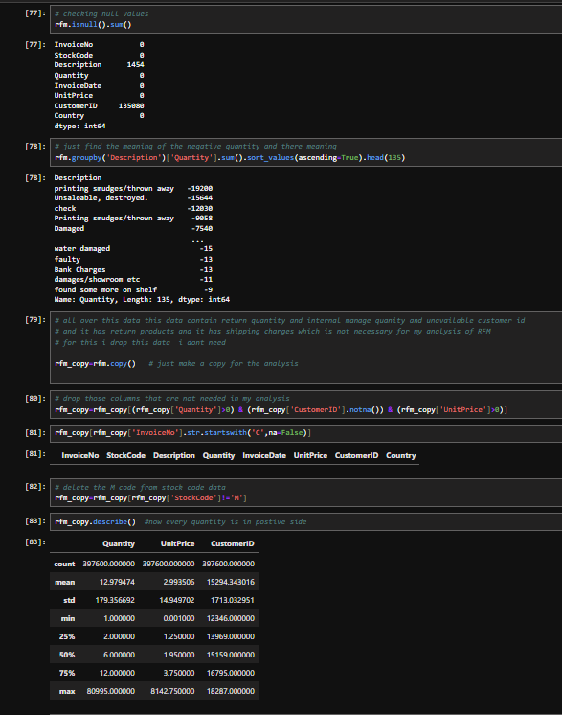
Data cleaning & preparation
Cleaning Steps Performed
Removed cancelled transactions and negative quantities
Excluded records with missing CustomerID
Converted date columns into proper datetime format
Why Cleaning is Important
Ensures accuracy of customer behavior analysis
Prevents incorrect frequency and monetary calculations

Slide 7
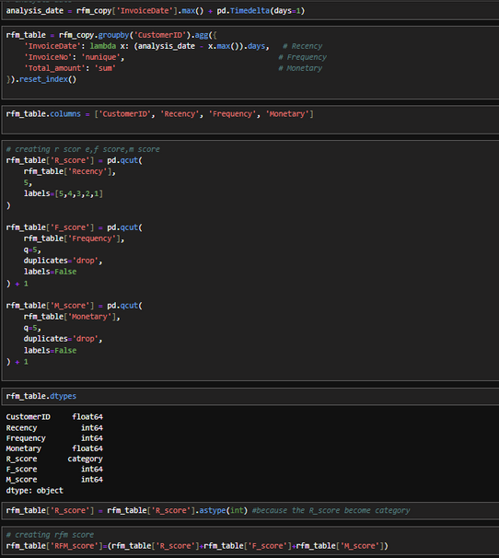
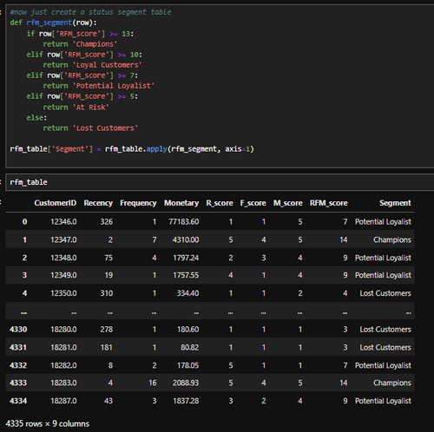
Feature Engineering
New Metrics Created
Total Amount = Quantity × Unit Price
Aggregate transactions at the customer level
Create a copy to ensure original data remains intact
Create R,F,M Score and segment status
Why Feature Engineering is Important
Ensures accuracy of customer behavior analysis
Prevents incorrect frequency and monetary calculations

Slide 8
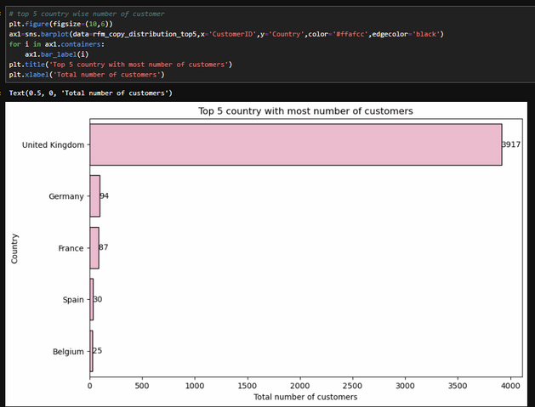
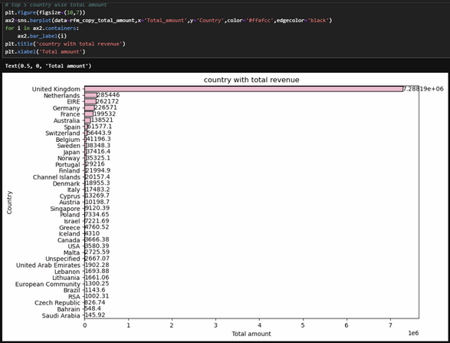
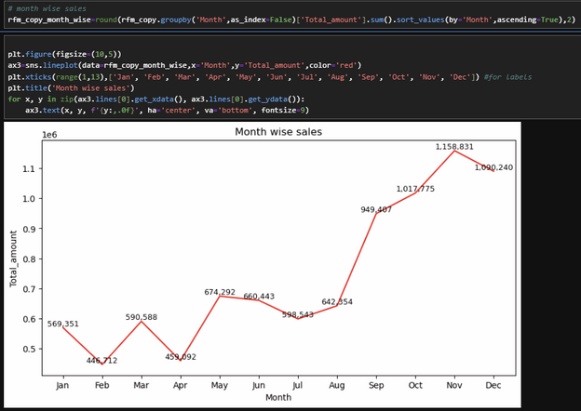
Customer distribution and sales
About customers
Top 5 country with highest number of customers
The total number of customers is 4,334.
Our customers come from a total of 37 different countries.
In terms of revenue, the UK, Netherlands, Ireland, Germany, and France rank at the top.
Sales show a clear upward trend towards the end of the year.
A noticeable increase is observed from September to November.
November records the highest sales, indicating strong seasonal demand.
Sales decline slightly after the peak period.
Revenue wise country
Month wise trend

Slide 9
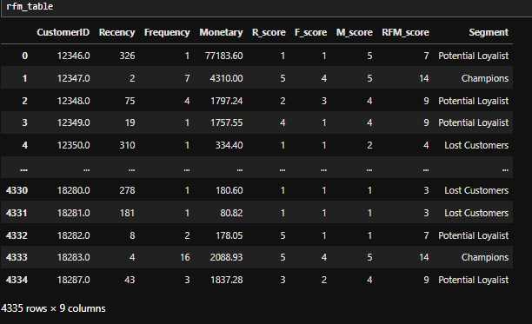
Understanding RFM Analysis
RFM Metrics Explained
Recency (R): Number of days since last purchase
Frequency (F): Total number of transactions
Monetary (M): Total spending amount
Business Interpretation
Recent customers are more likely to buy again
Frequent customers show engagement
High monetary customers generate more revenue
Score Range
RFM Scoring Methodology
Minimum: 3
Maximum: 15
Customers are divided into 5 equal groups (quantiles)
Each metric is scored from 1 (Lowest) to 5 (Highest)

Slide 10
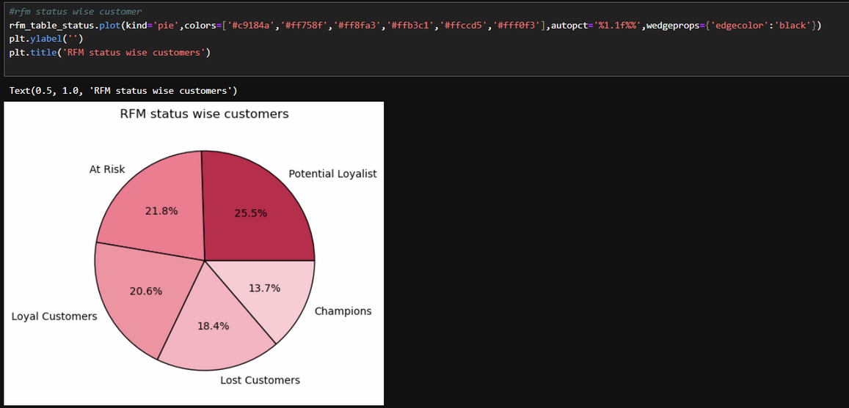


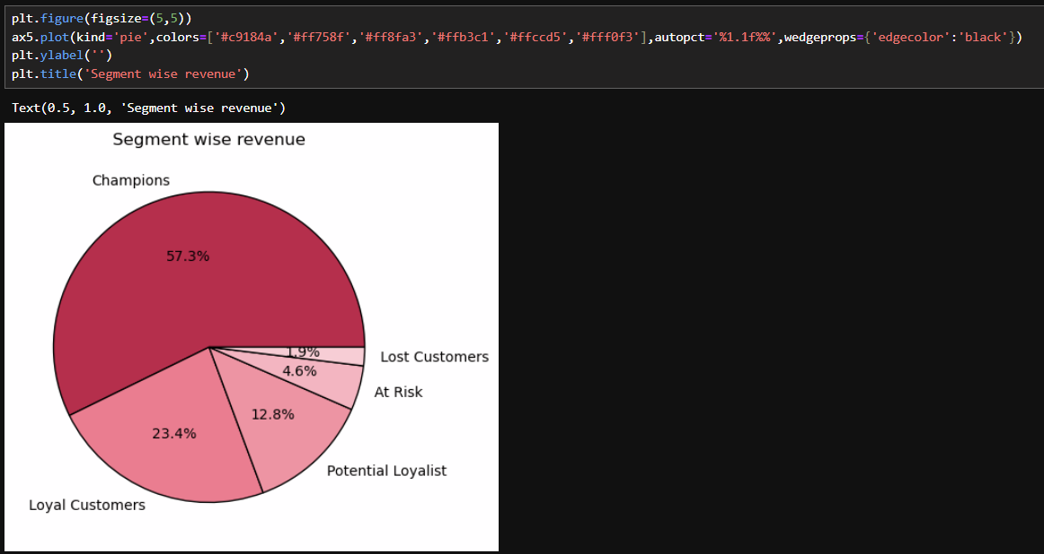

Customer Segmentation Logic
Segments Defined
13.7% of the customers are champions
20.6% of the customers are loyal customers
25.5% of the customers are potential loyalist
21.8% of the customers are at risk
18.4% of the lost customers
Revenue wise segments
57.3% of revenue come from champions
23.4% of revenue come from loyal customers
12.8% of revenue come from potential loyalist
4.6% of revenue come from at risk
1.9% of revenue come from lost customers

Slide 11
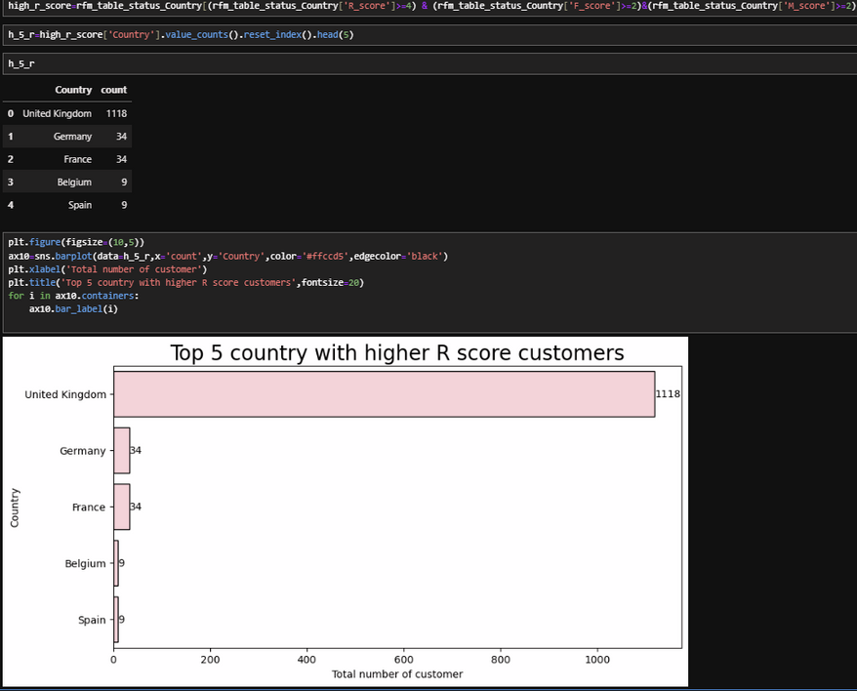
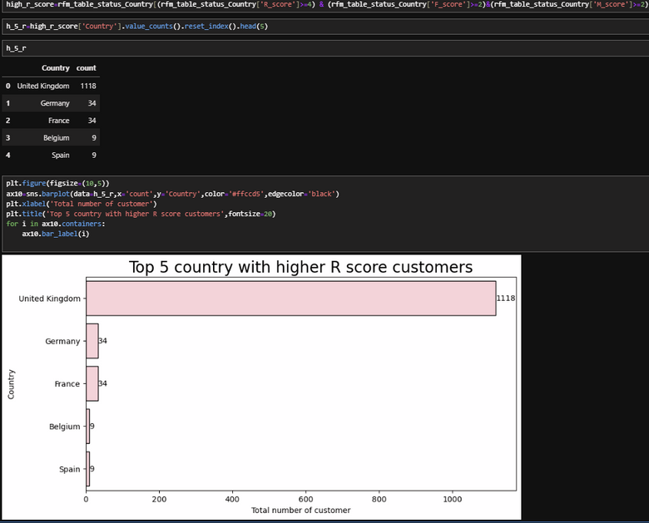
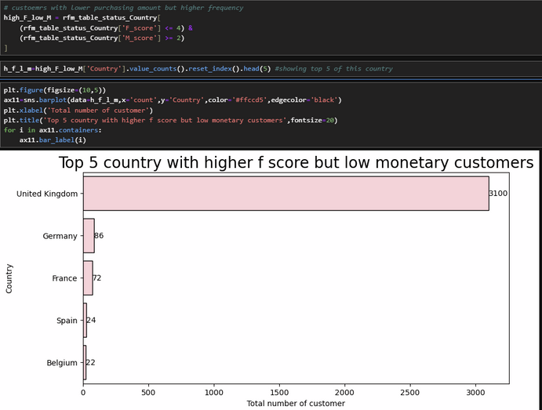
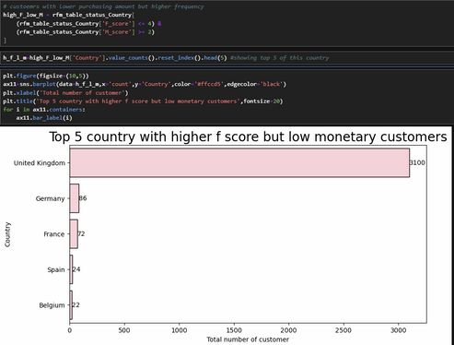
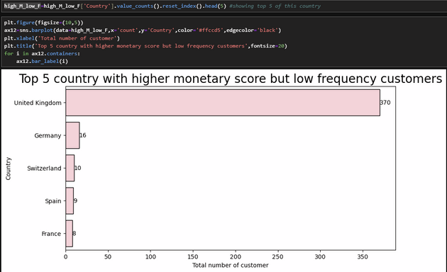
Types of customers
Loyal customers
There are top 5 countries who have most number of customers whose R_score is high
Customers with high frequency but low monetary
It’s evident that a significant portion of customers who make frequent purchases, albeit with an average amount, primarily come from the UK, Germany, France, Spain, and Belgium.
Customers with high monetary value but low frequency
You can observe that customers who make infrequent but high-value purchases primarily come from the UK, Germany, Switzerland, Spain, and France.

Slide 12
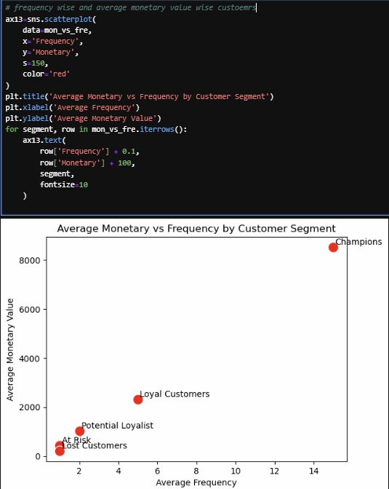

Customer Segment
The Relationship Among Monetary Value, Frequency, and Customer Segment
A strong positive correlation exists between purchase frequency and monetary value.
High-frequency customer segments generate significantly higher revenue.
Champions and Loyal customers contribute the highest average spending.

Slide 13
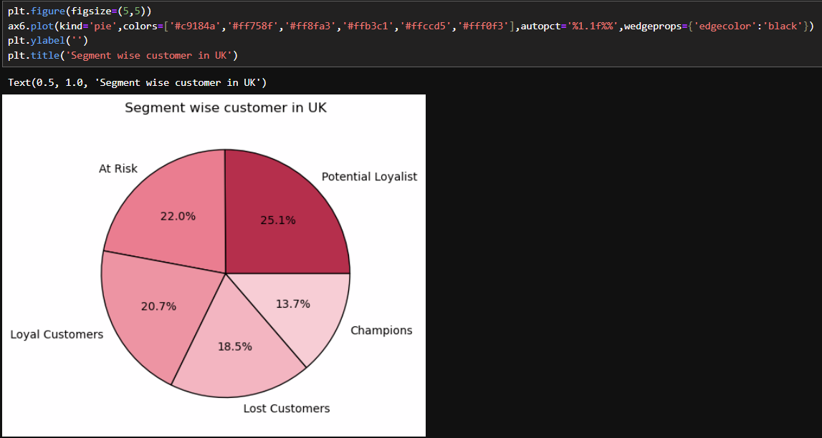
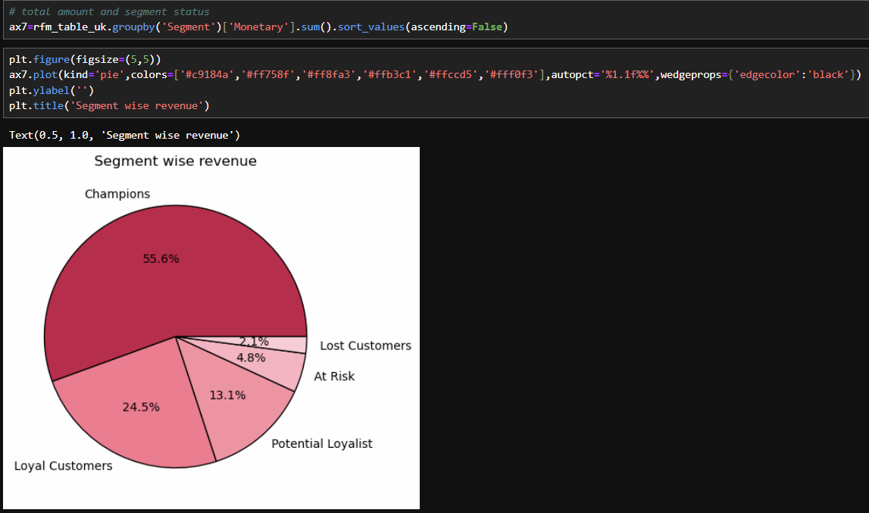
Deep drive to UK
Deep drive to the UK
Potential Loyalists dominate the UK customer base (25.1%)
At-Risk and Lost customers together form ~40% of customers
Champions are fewer but strategically critical
UK requires focused retention and conversion campaigns
Champions dominate UK revenue (55.6%) despite small customer share
Loyal customers add stable recurring revenue (24.5%)
Potential Loyalists offer strong revenue growth opportunity
At-Risk and Lost customers contribute minimal revenue

Slide 14
Business recommendation
Focus on Champions and Loyal Customers
Strengthen loyalty programs and provide exclusive offers to retain high-value customers.
Re-engage At-Risk Customers
Use personalized win-back campaigns and timely reminders to prevent customer churn.
Convert Potential Loyalists
Increase purchase frequency through targeted incentives, discounts, and bundled offers.
Reduce Spend on Lost Customers
Limit marketing efforts on low-value inactive customers to improve overall ROI.
Prioritize High-Value Countries
Allocate higher marketing budgets to top-performing regions such as the UK and other key markets.
Plan for Seasonal Demand
Align promotions and inventory planning with year-end sales peaks to maximize revenue.

Slide 15
Business recommendation
Protect Champions (55.6% of UK revenue)
Introduce VIP rewards, exclusive offers, and priority support to retain top spenders.
Strengthen Loyalty Programs(UK)
Loyal customers contribute ~25% of revenue—offer tiered benefits to increase engagement.
Convert Potential Loyalists (25% of customers of UK)
Use targeted discounts and repeat-purchase incentives to move them into Loyal segments.
Re-engage At-Risk Customers (UK)
Run personalized win-back campaigns to prevent further revenue loss.
Limit Spend on Lost Customers (UK)
Avoid heavy marketing investment due to low revenue contribution.
Focus UK Campaigns on Retention (UK)
Since revenue is highly concentrated, retention delivers higher ROI than acquisition.

Slide 16
Conclusion
This analysis used RFM segmentation, country-wise performance, and monthly trends to understand customer behavior and sales patterns. The results show that the UK is the strongest market, while other countries offer growth potential. RFM analysis helped identify loyal, potential, and at-risk customers, enabling targeted marketing strategies. Overall, the insights support better decision-making, improved customer retention, and sustainable revenue growth.
THANK YOU

